Slide 1
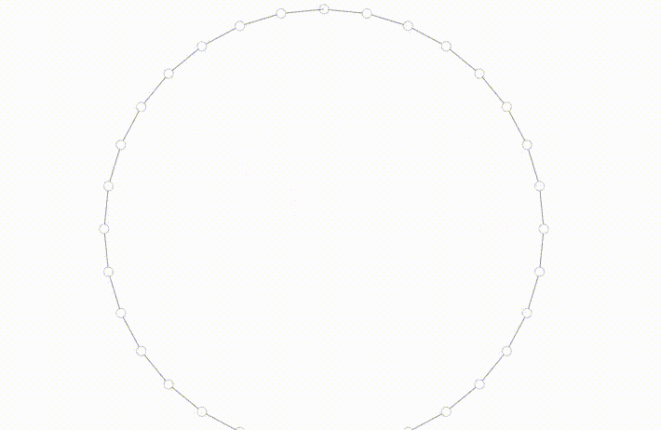
Principles of Network Analysis with NetworkX
Play along at: kaggle.com/stkbailey/ nashville-meetup/kernels
Notes:
Good morning!

Slide 2
Principles of Network Analysis with NetworkX
February 11, 2018
Stephen Bailey
kaggle.com/stkbailey/Nashville-meetup
Notes:
- Stephen Bailey, currently a grad student
- Relatively new to PyNash – don’t know much about software engineering
– pretty hacky most of the time.
But I love Python because if you can dream it, someone’s done it
One thing I do know about is networks.

Slide 3

Who’s this for?
I want to know what a graph is.
I want to do graph analysis in Python but don’t know how.
I have some data that may have interesting relationships but don’t know how to analyze.
Notes:
I assume some familiarity with data analysis in Python, but none with NetworkX

Slide 4
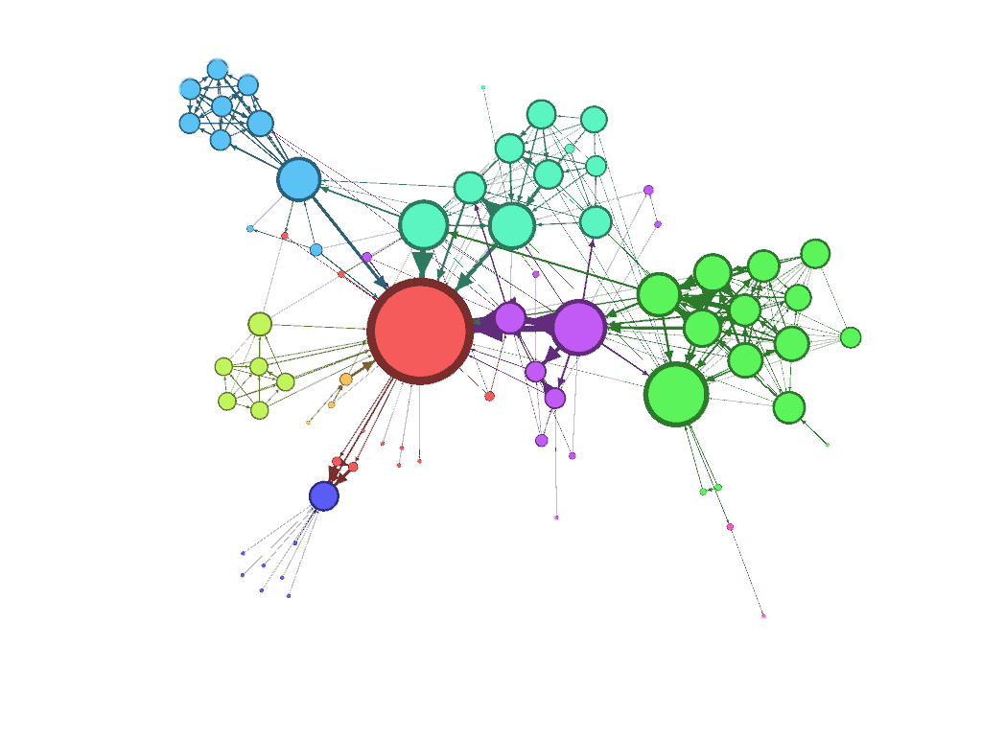
Principles of Network Analysis with NetworkX
What is a network?
Build a network
Measure a network
Plot a network

Slide 5
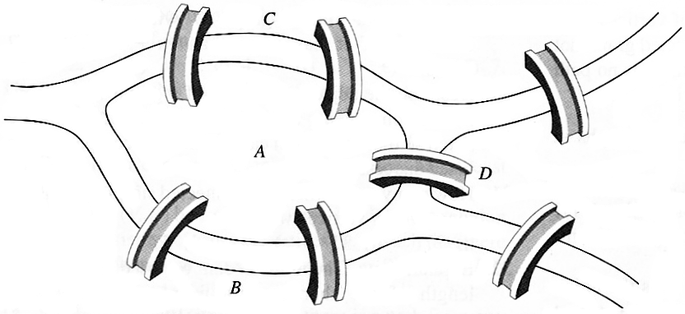
Can you traverse every bridge just once?
C
 | A | B | C | D
A | - | 2 | 2 | 1
B | 2 | - | 0 | 1
C | 2 | 0 | - | 1
D | 1 | 1 | 1 | -
A
D
B

Slide 6
Graph
C
Node
A has the most connections
A
D
Edge
B
A & D are connected to all other nodes
Notes:
Without knowing anything about this system, what is one thing you might say?
B seems to be the most “important” place – has the most connections.
B and C are seem to be more central to the graph – A and D are both on the edges

Slide 7
1
1
To travel into AND out of a node, requires 2 edges.
Therefore… either:
All nodes have an even number of edges.
Exactly two nodes have an odd number of edges.
2
2
1
3
2
Notes:
Without knowing anything about this system, what is one thing you might say?
B seems to be the most “important” place – has the most connections.
B and C are seem to be more central to the graph – A and D are both on the edges

Slide 8
Back to Konigsberg…
3
5
3
Four nodes with odd number of edges!
3
Notes:
Without knowing anything about this system, what is one thing you might say?
B seems to be the most “important” place – has the most connections.
B and C are seem to be more central to the graph – A and D are both on the edges

Slide 9
That’s the ticket…
3
4
3
2
Notes:
Without knowing anything about this system, what is one thing you might say?
B seems to be the most “important” place – has the most connections.
B and C are seem to be more central to the graph – A and D are both on the edges

Slide 10
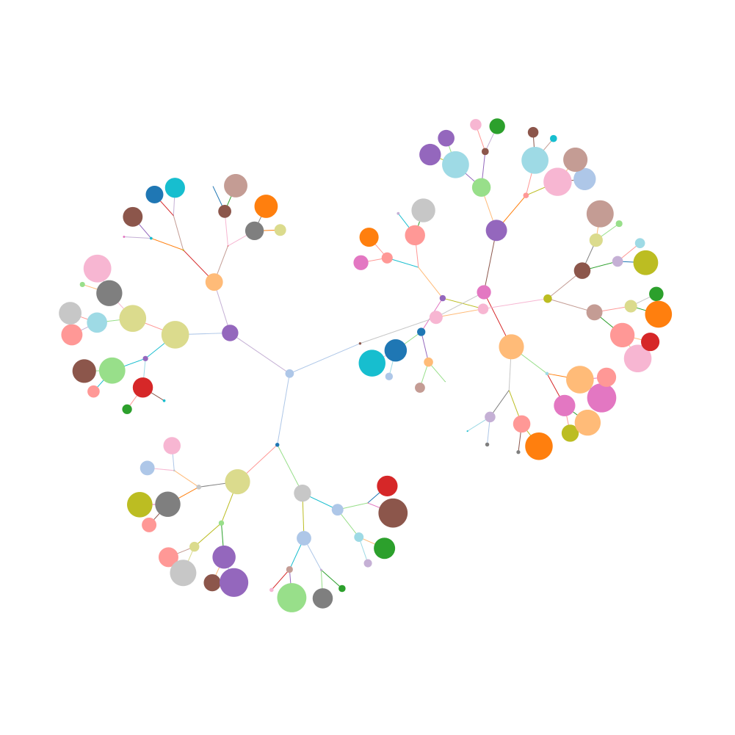
Graphs
Useful for understanding relationships.
Describe topology (arrangement) of networks.
Many derivative measurements.

Slide 11
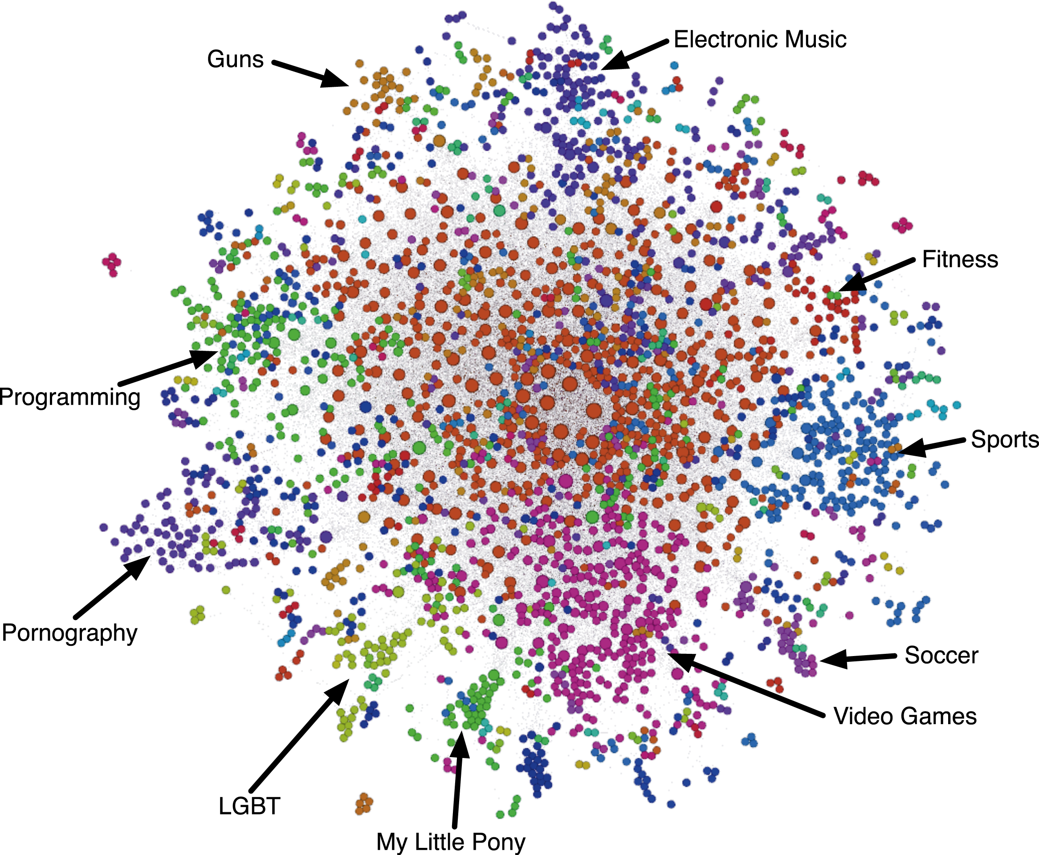
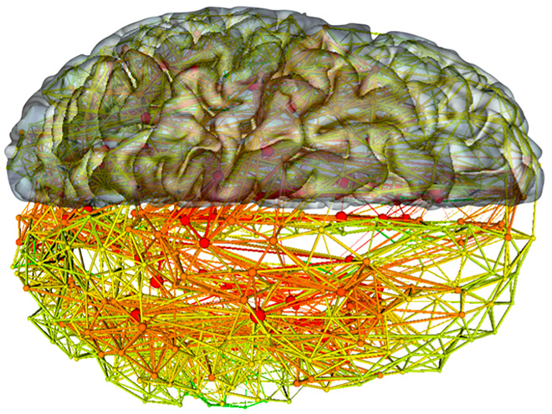
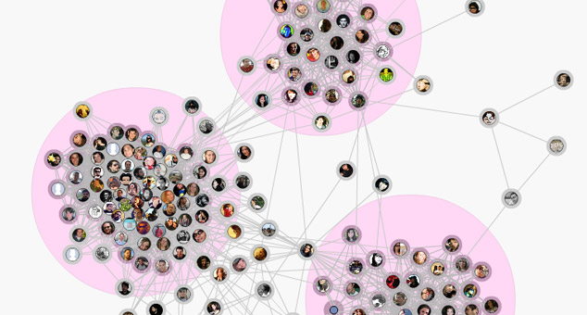
Notes:
Without knowing anything about this system, what is one thing you might say?
B seems to be the most “important” place – has the most connections.
B and C are seem to be more central to the graph – A and D are both on the edges

Slide 12
Principles of Network Analysis with NetworkX
What is a network?
Build a network
Measure a network
Plot a network

Slide 13
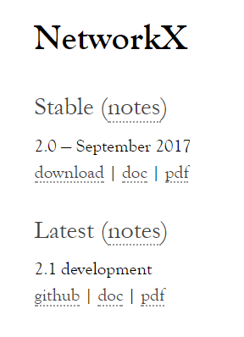
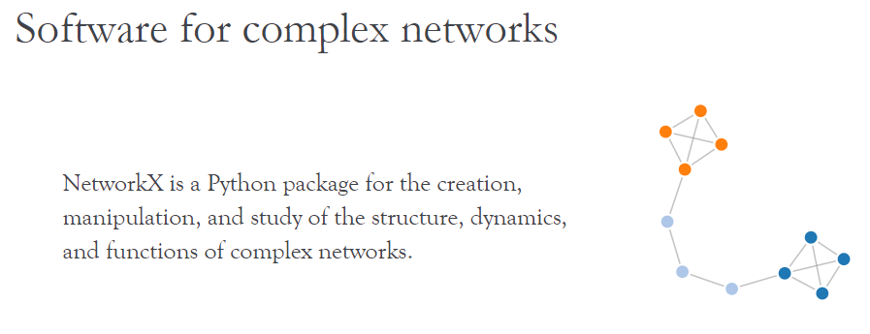
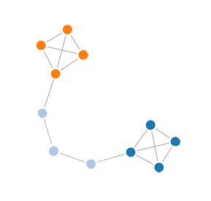
Notes:
- pure Python
- open source
- just released new version recently
- Plays well with Pandas
- Can generate other graph formats very well! Even if you just want to translate something so you can plot it, it can be a useful intermediary.
- Fast

Slide 14
Initializing a graph
import networkx as nx
g = nx.Graph()
g
Other graph classes:
DiGraph
MultiGraph
MultiDiGraph
<networkx.classes.graph.Graph>

Slide 15
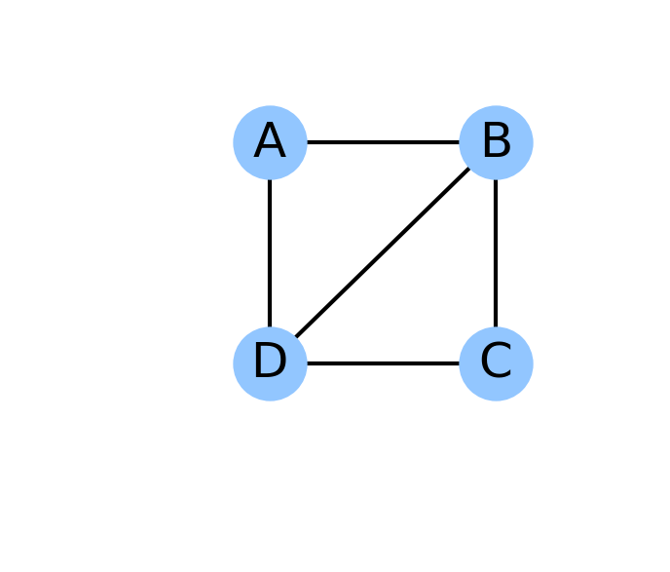
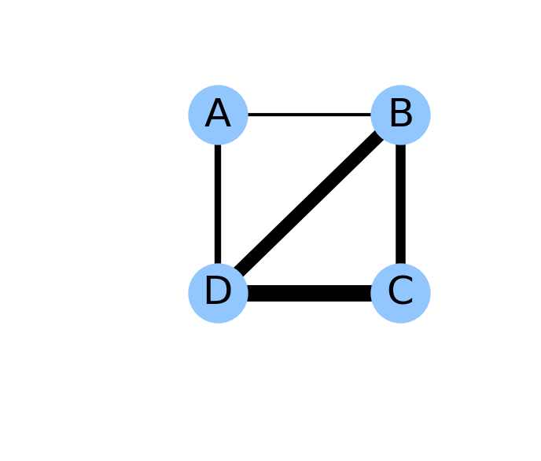
Undirected (nx.Graph)
Binary
Weighted
Directed (nx.DiGraph)
Binary
Weighted
Notes:
Undirected, binary: LinkedIn Connection
Undirected, weighted: Compatibility Score (OK-Cupid)
Directed, binary: Org chart / management chart
Directed, weighted: Emails sent
Multi-graph: Number of interactions, across different platforms
If you can dream it, you can do it!

Slide 16
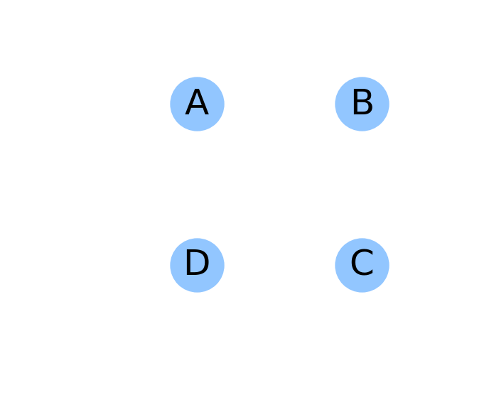
Adding nodes manually
g.add_node('A')
g.add_node('B')
g.add_node('C')
g.add_node('D')
g.nodes
['A', 'B', 'C', 'D']

Slide 17
Adding edges manually
g.add_edge(u='A', v='B')
g.add_edge('A', 'D')
g.add_edge('B', 'C’)
g.add_edge('B', 'D')
g.add_edge('C', 'D')
g.edges
[('A', 'B'), ('A', 'D'), ('B', 'C'), ('B', 'D'), ('C', 'D')]

Slide 18
Setting attributes
edge_weights = { ('A', 'B'): 1,
('A', 'D'): 2, …}
nx.set_edge_attributes(
G=g,
values=edge_weights,
name='weight’)
g.edges(data=True)
[('A', 'B', {'weight': 1}), ('A', 'D', {'weight': 2}), ('B', 'D', {'weight': 3})…]

Slide 19
Graph objects are (basically) dicts-of-dicts-of-dicts
g['A']
g['A']['B']
AtlasView({
'B': {'weight': 1},
'D': {'weight': 2}
})
{'weight': 1}
g['A']['B']['weight']
1

Slide 20
Edge List: The heart of a graph
If you can put your data into an iterable of edges, then you can quickly construct a graph.
source | target | weight
A | B | 1
A | D | 2
B | D | 3
B | C | 4
C | D | 5
g = nx.from_edgelist(el)

Slide 21
Principles of Network Analysis with NetworkX
What is a network?
Build a network
Measure a network
Plot a network

Slide 22




Slide 23

Graphing Nashville MeetUps
Data available via REST API.
Members join Groups online and RSVP to events.
We only count a member-group mapping as valid if they have RSVPed to 2 events in the past year.
Create two networks:
Relationships between groups
i.e., # of shared members
Relationships between members
i.e, # of shared groups

Slide 24

Graphing Nashville MeetUps
PyNash
Martin
Chevy
Steve
Nashville Salsa Congress

Slide 25




Member & Group Graphs
2
1
1
2

Slide 26
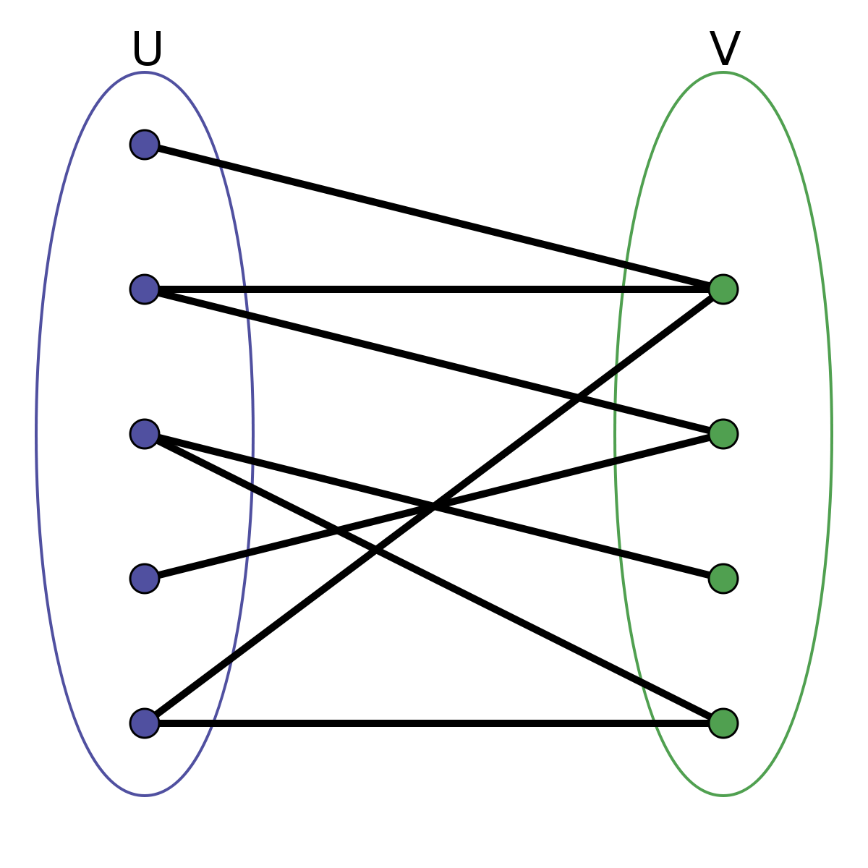
Sidebar: Bipartite graphs
People
Groups
Other examples:
Actor → Movie
Student → School
Person → Hobby
Two classes,
No within-class
connections
g = weighted_projected_graph(
bipartite_graph,
list_of_class_nodes)

Slide 27
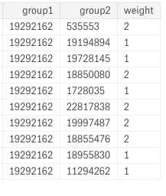
Let’s do it!
group_edges = pd.read_csv('group-edges.csv')
g = nx.from_pandas_edgelist(
df = group_edges,
source = 'group1',
target = 'group2',
edge_attr = 'weight')

Slide 28
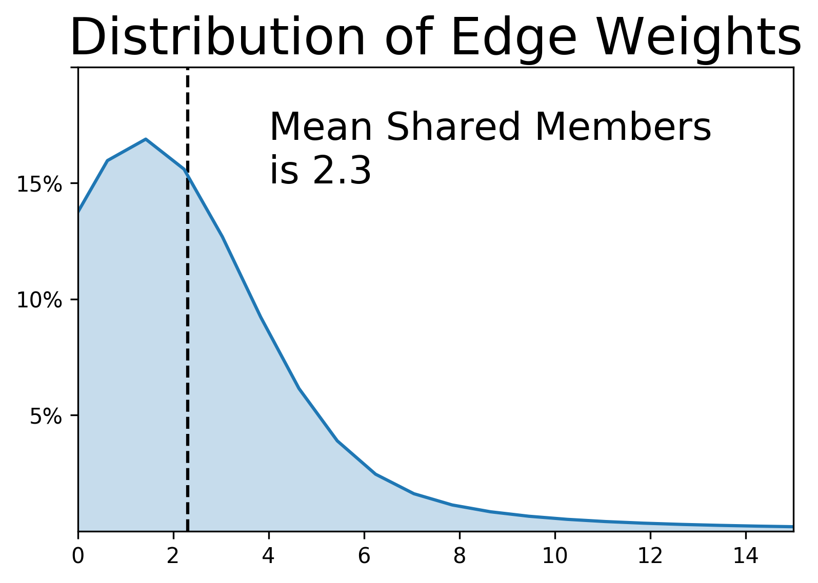
Group Graph Breakdown
Metric | Command | Value
Num. Groups | len(g.nodes) | 446
Num. Cnxns | len(g.edges) | 6692

Slide 29
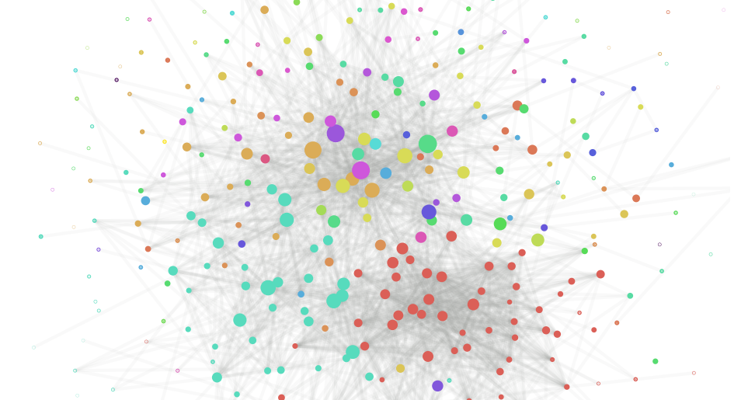
Music City Drinking Buddies
Biz
TECH
Group Shared
Membership,
Colored by
Group Category

Slide 30
Graph Measures: General principles
Typically accessed via nx.some_algorithm(g)
Often returns a dictionary of {node: value, …}
Interpretations depend on data!
# Example measures
nx.degree(g)
nx.clustering(g)
nx.shortest_path(g)
nx.betweenness_ centrality(g)

Slide 31
Graph Measures: Degree
Total number of edges at a node
3
5
3
3

Slide 32
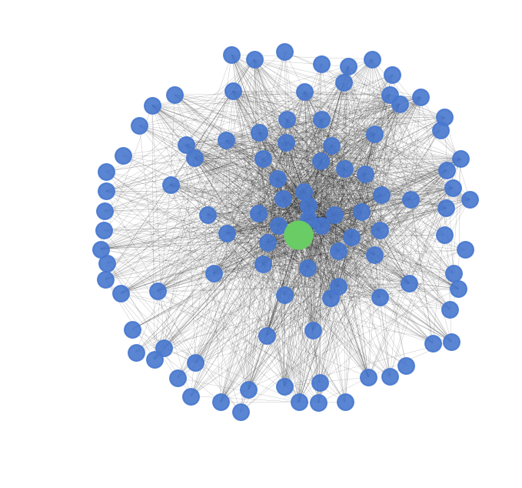
Graph Measures: Degree
Total number of edges at a node
deg = nx.degree(g)
deg['PyNash']
101

Slide 33
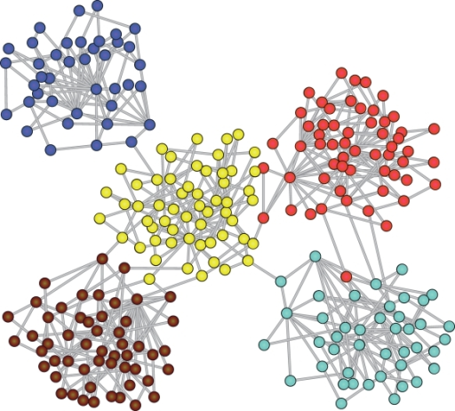
Graph Measures: Clustering
Likelihood of a node’s connections also being connected
nx.clustering(g)

Slide 34
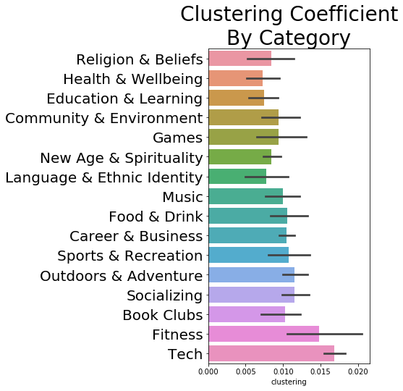
Low Clustering
Drinking Buddies
Movie Lovers
Free & Cheap Events
Nash. Musicians
High Clustering
Nash.JS
Nashville D&D
Data Science Nash.
Mid TN 40+ Singles
Less
More

Slide 35
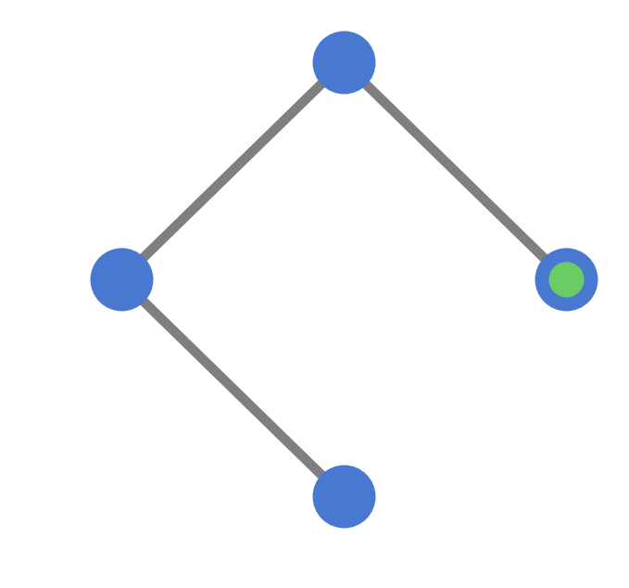
Graph Measures: Path Length
Number of “steps” to get from one node to another
TN Hiking
Group
Strictly
Belcourt
nx.shortest_path_length(
G=g,
source='PyNash',
target='CostumedRevelers')
PyNash
Costumed
Revelers

Slide 36
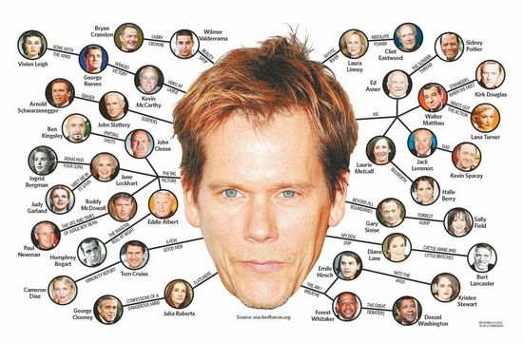

Slide 37
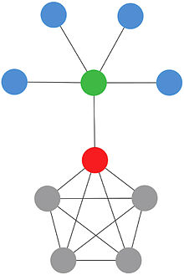
Graph Measures: Centrality
How important a node is to connecting the whole network
nx.betweenness_centrality(g)
Important metric – often used to assess “vulnerability”

Slide 38
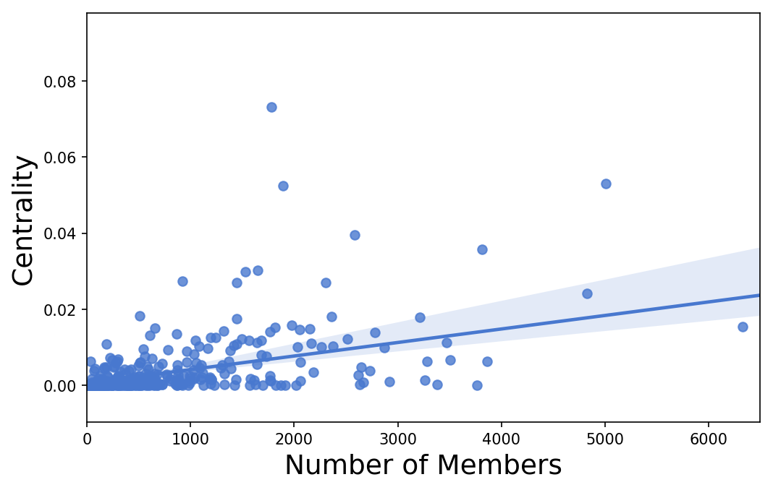
Centrality is not simply the “size” – it is also who they connect.
Social Dance
Paddle Adventures Unlimited
Notes:
You might attend a lot of events with people, but you may not be getting out of your “bubble” – you might go to a lot of tech events, for example.

Slide 39
The groups that tie Nashville together
Group Name | Category | Centrality
Stepping Out Social Dance | Dancing | 0.0731
Eat Love Nash | Socializing | 0.0531
What the Pho! | Food & Drink | 0.0525
Middle TN 40+ singles | Singles | 0.0394
Nashville Hiking Meetup | Outdoors & Adventure | 0.0362
20s in Nashville | Socializing | 0.0357
Nashville SEO | Career & Business | 0.0301

Slide 40
Adding measures to a DataFrame
Since measures are output as dictionaries, you can add them to node-indexed DataFrames by converting them into Series.
from pandas import DataFrame
df = DataFrame(index=g.nodes)
clust = nx.clustering(g)
df['clust'] = pd.Series(clust)

Slide 41
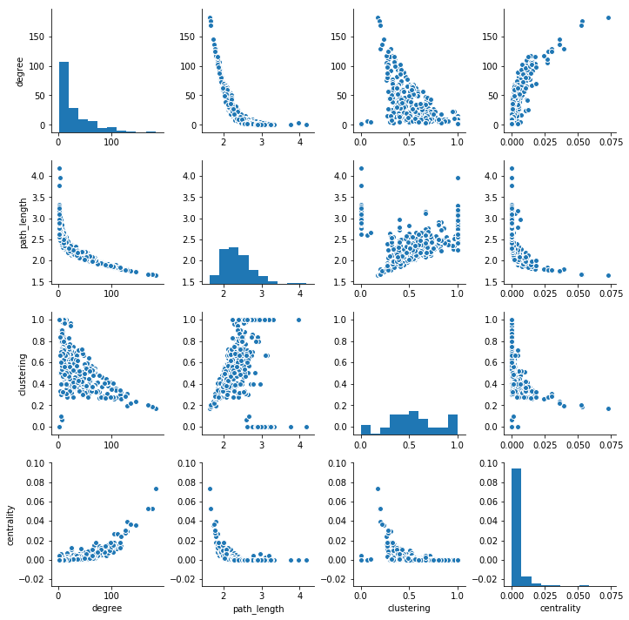
Once in a DataFrame, traditional plots are possible.
Degree
Path
Length
Measures are often correlated with each other, especially in simple graphs.
Clustering
Centrality
Degree
Path Length
Clustering
Centrality

Slide 42
What group to join?
To infiltrate the network…
- Attend groups with high centrality and degree
To go deep in a community…
- Attend MeetUps with high clustering, and go to several connected ones
… But who do I talk to???

Slide 43
Member & Group Graphs
2
1
1
2

Slide 44

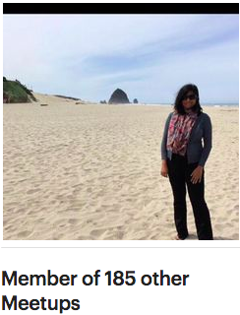
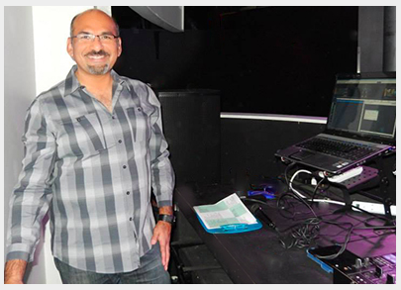
Nashville’s Elite Meeter-Uppers
Notes:
Shalini
DJ Pablo

Slide 45
Principles of Network Analysis with NetworkX
What is a network?
Build a network
Measure a network
Plot a network

Slide 46
Plotting with NetworkX and Matplotlib
Generally, three steps:
Arrange nodes
Plot graph
Adjust figure
pos = nx.spring_layout(g)
nx.draw_networkx(g, pos)
plt.show()

Slide 47
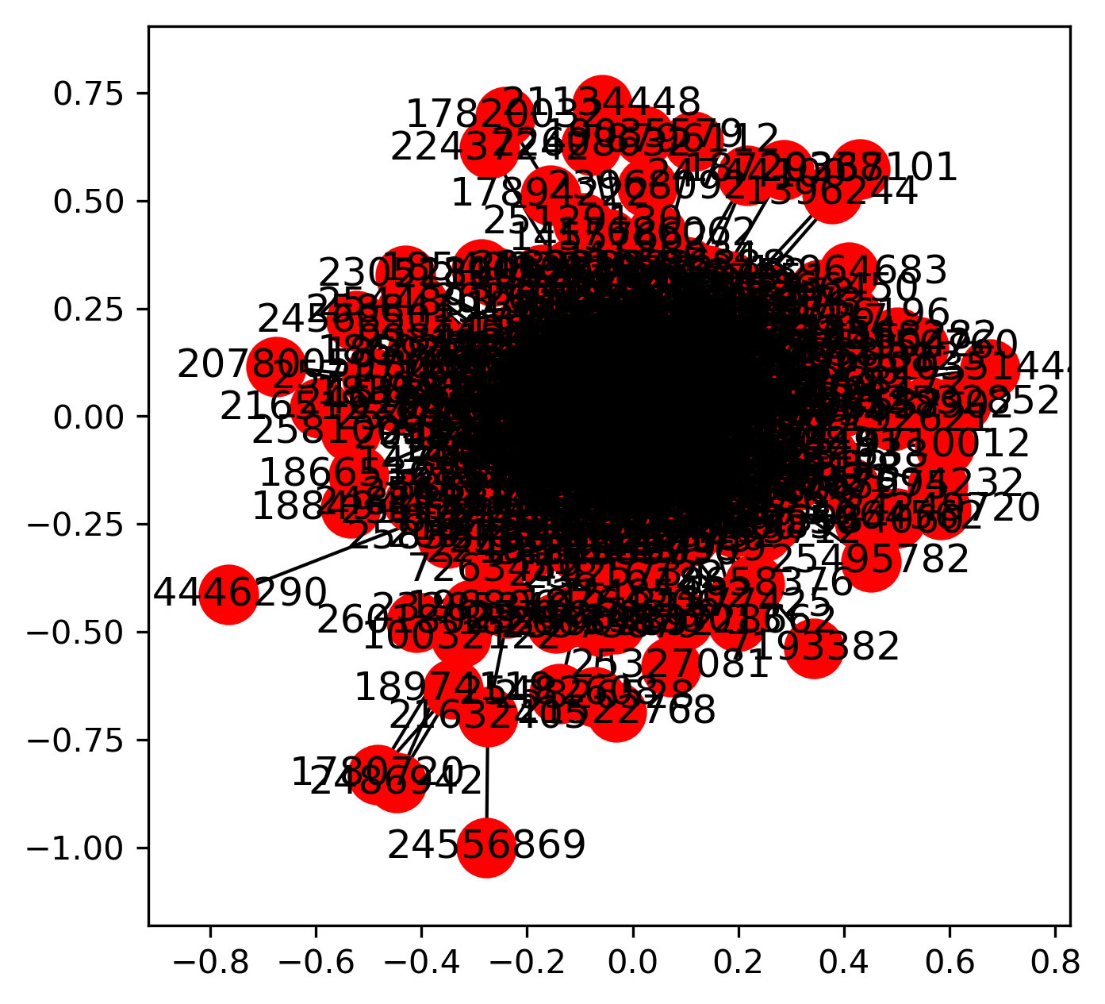
Full Defaults
The essence of beauty

Slide 48
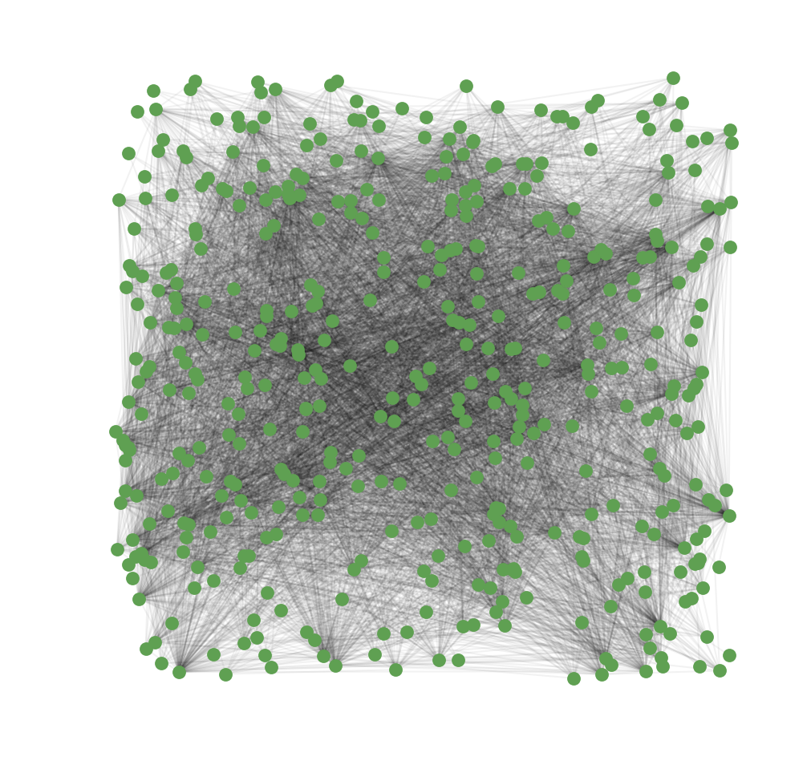
The Random Layout
Nodes are placed randomly throughout the graph.
pos = nx.random_layout(g)

Slide 49
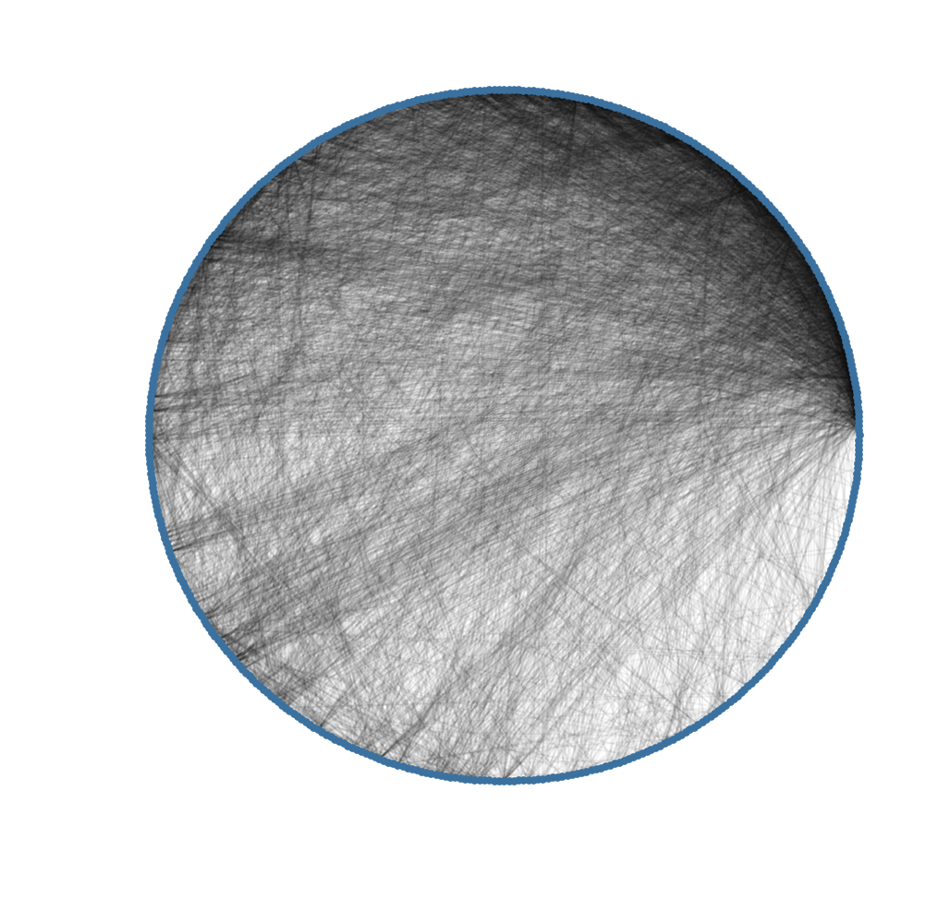
The Circular Layout
Nodes aligned on outside, all edges “contained”
pos = nx.circular_layout(g)

Slide 50
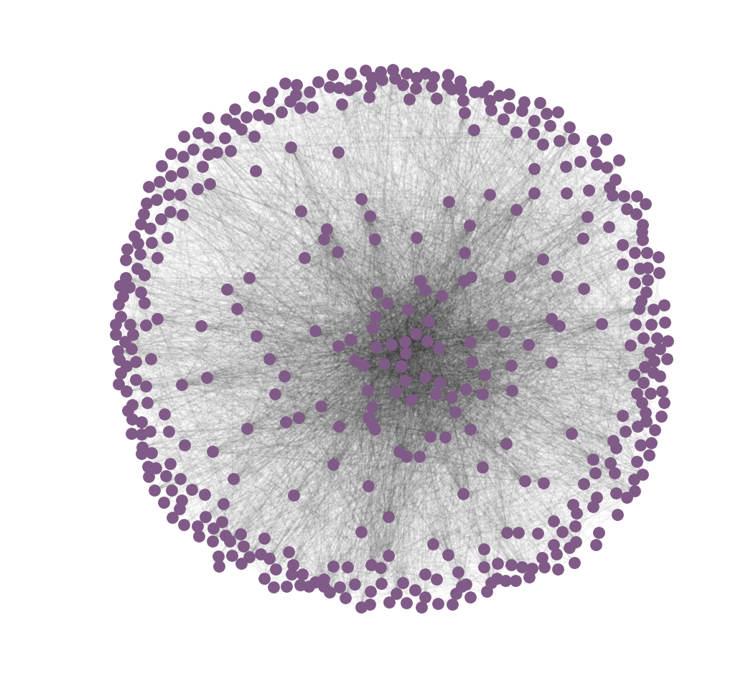
The Spring Layout
Nodes ”spring” from the center, getting pushed further if they are less densely connected.
Densely connected
pos = nx.spring_layout(g, k=2)
Loosely connected

Slide 51
Plotting with NetworkX and Matplotlib
Can break drawing step into stages for more precise handling.
# Common Plot Attributes
with_labels=False
node_color=None
node_size=100
width=1 # edge width
alpha=1 # transparency
nx.draw_networkx_nodes
nx.draw_networkx_edges
nx.draw_networkx_labels

Slide 52
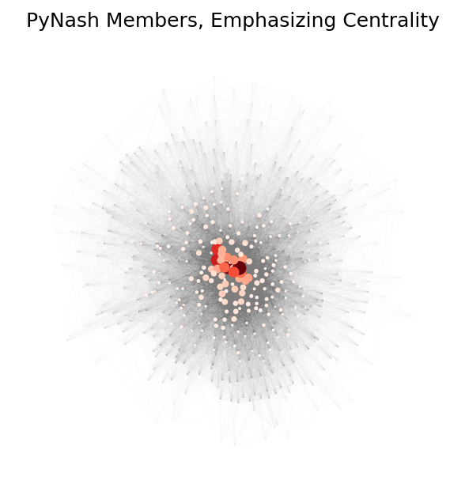
The Spring Layout: Emphasizing centrality
Member relationships in PyNash
More central nodes are brighter red and larger.

Slide 53
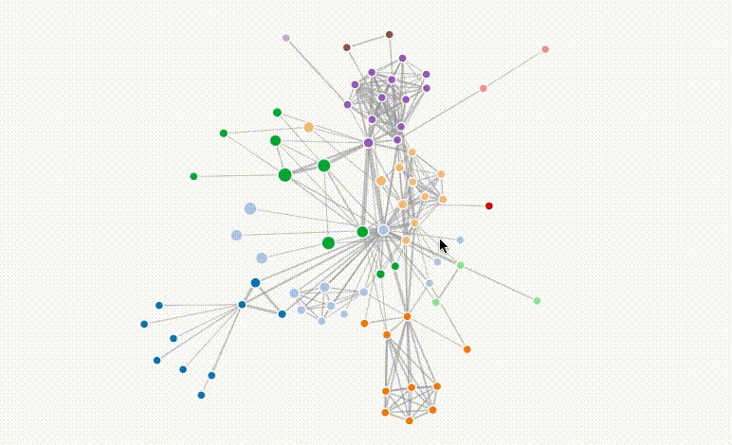
Exporting graph data
There are many other graph analysis packages and tools, especially for plotting
- d3.js
- Plotly
- GraphViz
- Neo4j
nx.write_pajek(g, fname)

Slide 54
Principles of Network Analysis with NetworkX
What is a network?
Build a network
Measure a network
Plot a network

Slide 55
Take-Aways
Principles
Networkx
Garbage in, garbage out
Spend time preprocessing edges BEFORE creating the graph
Measures
Degree – first stop
Clustering – “clumping”
Centrality – “influence”
Use color & transparency for more comprehensible plots
NetworkX is excellent for Pythonic exploration of data:
I/O
Analysis
Visualization
For very large graphs, some operations can take a long time.

Slide 56
